Slide 1
Implementation and validation of the magnetized Poisson-Vlasov-Fokker-Planck framework
Fabiano Sasselli, CSE Semester Project HS22
Supervisor: Kyoungseoun Chung
Professor : Prof. Dr. Patrick Jenny
Fabiano Sasselli
22.12.2022

Slide 2
Contents overview
Introduction
Magnetized Poisson Vlasov-Fokker-Planck equation
Results and discussion
Conclusions

Slide 3
Introduction

Slide 4
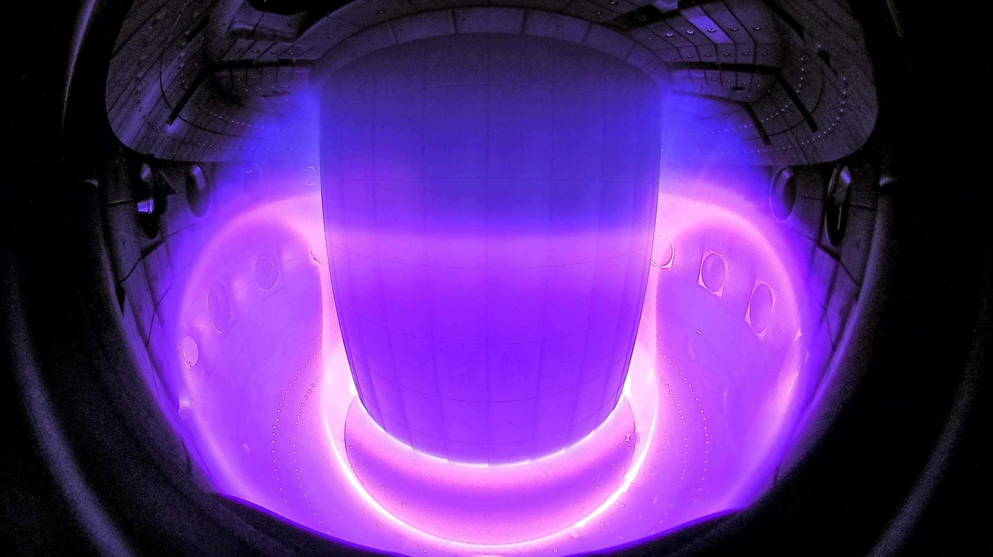
Motivation
Objective
Problems
Accurate and computationally efficient simulation of plasma flow
Wide range of time and length scales
Multiple species
Coulomb collisions
Electromagnetic interaction
Multiple modeling approaches
Magnetohydrodynamic
Two fluid model
Kinetic description
Fig: Curdin Wüthrich /SPC/EPFL, https://actu.epfl.ch/news/epfl-and-deepmind-use-ai-to-control-plasmas-for-nu/

Slide 5
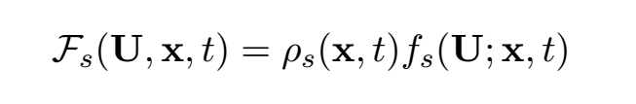
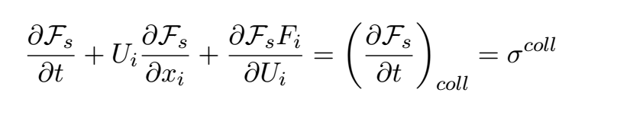
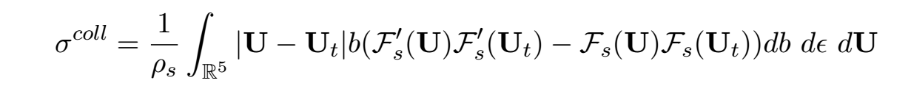
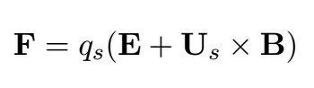
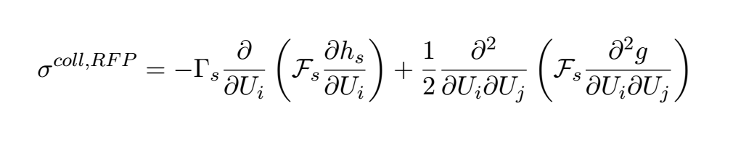
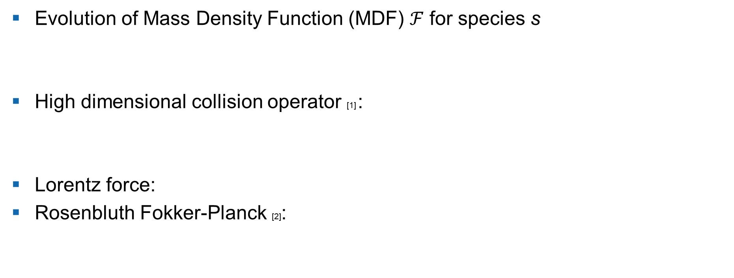
Kinetic model-Boltzmann Transport Equation
Evolution of Mass Density Function (MDF) $ℱ$ for species s
High dimensional collision operator [1] :
Lorentz force:
Rosenbluth Fokker-Planck [2]:
drift
diffusion
$$s$$
$U_{i}:$ i-th velocity component of $U$, $U_{t}:$ post collision velocity ,B$:$ magnetic field, E$:$ electric field, $b:$ collision parameter, $ε:$ collision angle, $q_{s}:$ charge species s,
$ρ_{s}:$ density, $k_{b}:$ Boltzmann constant, $g_{s},h_{s}:$ Rosenbluth potentials
[1] P. Jenny et. al., A solution algorithm for the fluid dynamic equations based on a stochastic model for molecular motion, (2009)
[2] M.N. Rosenbluth et. al., Fokker-Planck Equation for an Inverse-Square Force, Physical Review (1957)

Slide 6
Magnetized Poisson Vlasov-Fokker-Planck Equation

Slide 7
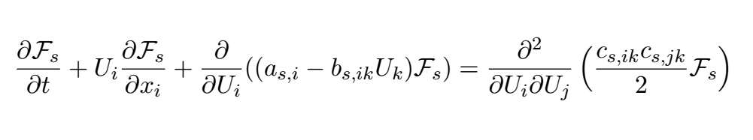
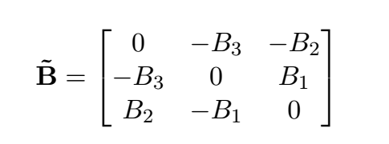
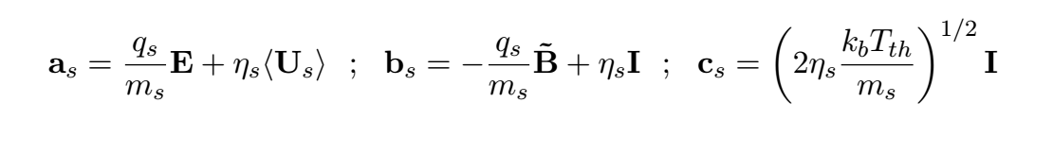
Magnetized Poisson Vlasov-Fokker-Planck Equation
Constant external magnetic field (magnetized)
Linear drift, constant diffusion Fokker-Planck model [1], [2]
$η_{s}:$ friction coefficient, $\left\langle U_{s}\right\rangle :$ mean bath velocity, $T_{th}:$ temperature, $m_{s}:$ mass species s, $k_{b}:$ Boltzmann constant
[1] P. Jenny, H. Gorji, Accurate time integration for solving Vlasov-Fokker-Planck equations with specified electromagnetic fields, J. Comput. Phys, (2019)
[2] P. Jenny et. al., A solution algorithm for the fluid dynamic equations based on a stochastic model for molecular motion, (2009)

Slide 8
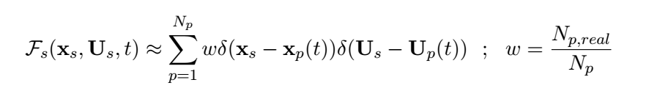
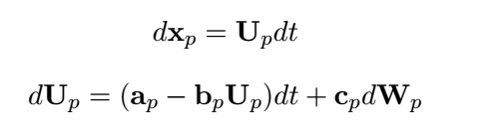
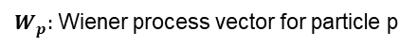
Particle Method
Approximate MDF using computational particles
Easier computation through Langevin formulation [1]
Problem: magnetic field-velocity coupling (vector product in Lorentz force)
$U_{s}:$ species s velocity vector,$U_{p}:$ velocity vector for particle p of species s, $δ:$ delta function, $w:$ statistical weight, $N_{p}:$ number of computational particles for species s
$x_{p}:$ position vector for particle p of species s, $x_{s}:$ position vector for species s
$W_{p}:$ Wiener process vector for particle p
[1] P. Jenny, H. Gorji, Accurate time integration for solving Vlasov-Fokker-Planck equations with specified electromagnetic fields, J. Comput. Phys, (2019)

Slide 9
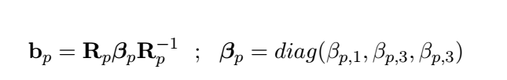
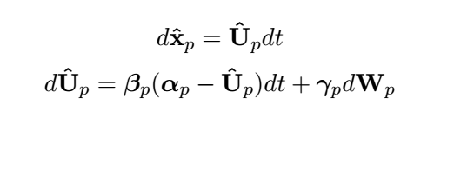
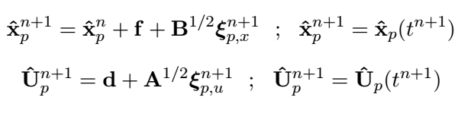
Accurate time integration [1]
Decoupling
Exact integration of SDE
$α_{p}=β_{p}^{−1}R^{−1}a$, $γ_{p}=R^{−1}c$, ${\hat{U}}_{p}=R^{−1}U_{P},{\hat{x}}_{p}=R^{−1}x_{p}$, $ξ_{p, x},ξ_{p, u}$: correlated random vectors, $d,A,f,B:model coefficients$
[1] P. Jenny, H. Gorji, Accurate time integration for solving Vlasov-Fokker-Planck equations with specified electromagnetic fields, J. Comput. Phys, (2019)

Slide 10
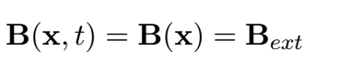
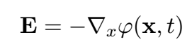
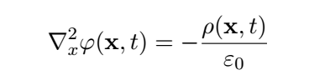
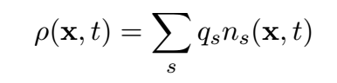
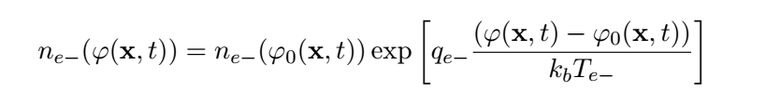
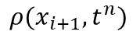
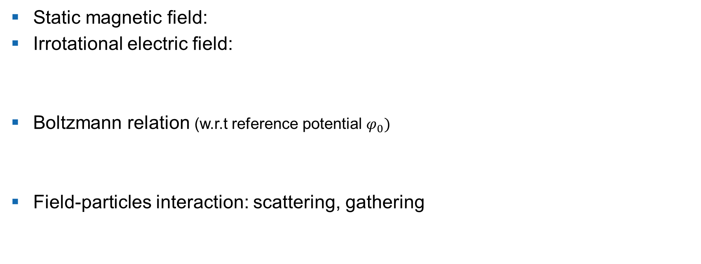
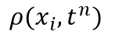
Electromagnetic field Potential $φ$Poisson equation
Static magnetic field:
Irrotational electric field:
Boltzmann relation (w.r.t reference potential $φ_{0})$
Field-particles interaction: scattering, gathering
$$ρ(x_{i},t^{n})$$
$$ρ(x_{i+1},t^{n})$$
$n_{e−}:$ Electrons number density, $n_{s}$ : number density of species s, $q_{e−}$: electron charge, $ε_{0}$: vacuum permittivity, $T_{e−}$: electron charge

Slide 11
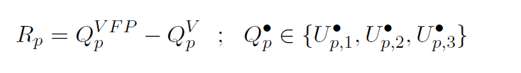
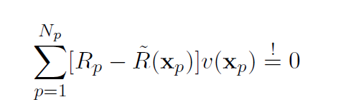
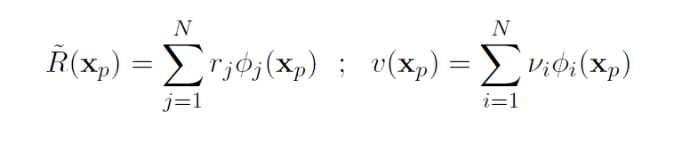
Velocity field correction Momentum correction
Collision velocity contribution for particle p
Momentum of binary collisions conserved globally
$N:$ number of grid nodes, $r_{j},ν_{i}$ : basis function coefficients, $VFP$: Vlasov Fokker-Planck eqn., $V$: Vlasov eqn. (collisionless), $φ$: Basis function

Slide 12
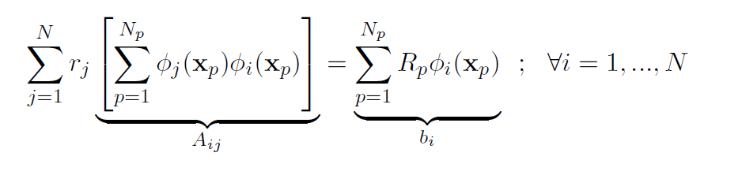
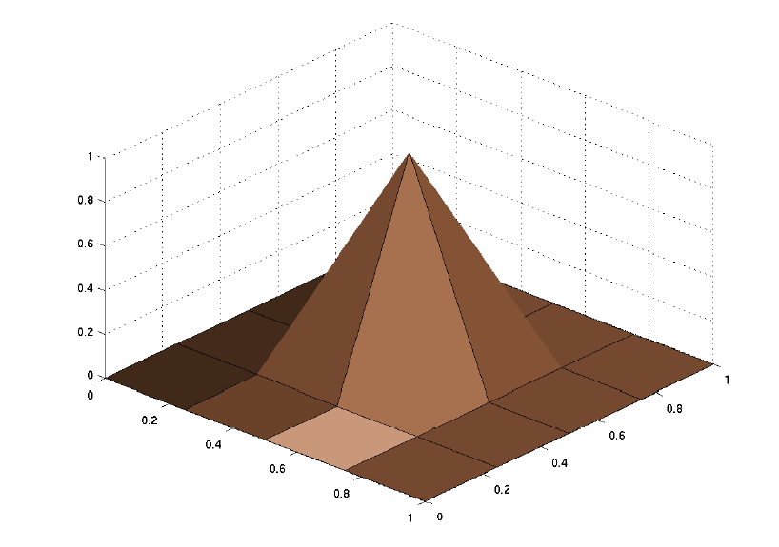
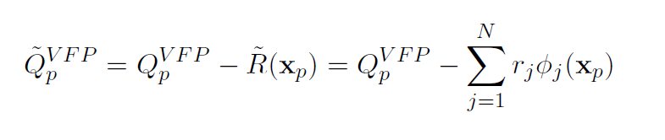
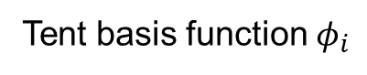
Tent basis function $φ_{i}$
Particle velocity correction
Fig: Prof. Ralf Hiptmair ETH Zürich, “Numerical Methods for Partial Differential Equations” lecture notes
${\tilde{Q}}_{p}^{VFP}:$ momentum corrected collision velocity, $r_{j},ν_{i}$ : basis function coefficients, $VFP$: Vlasov Fokker-Planck eqn., $V$: Vlasov eqn. (collisionless)

Slide 13
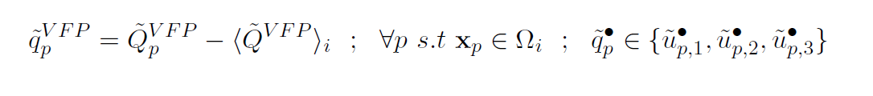
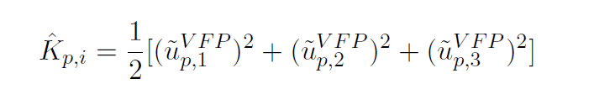
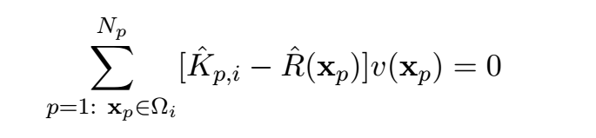
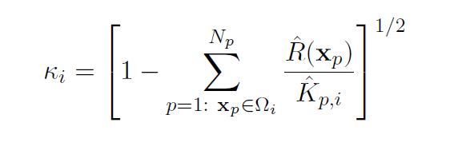
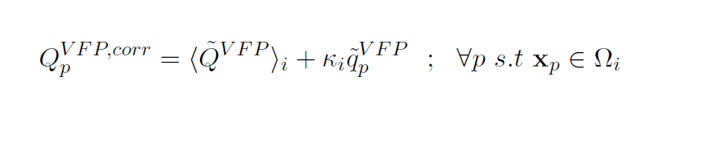
Velocity field correction Energy correction
Similar procedure as momentum correction
Cell correction coefficient
${\tilde{q}}_{p}^{VFP}:$ momentum corrected collision velocity fluctuation,${\hat{K}}_{p,i}$: Kinetic energy for particle p in cell I, ${⟨\tilde{Q}}_{i}^{VFP}⟩:$ momentum corrected mean collision velocity for cell i

Slide 14
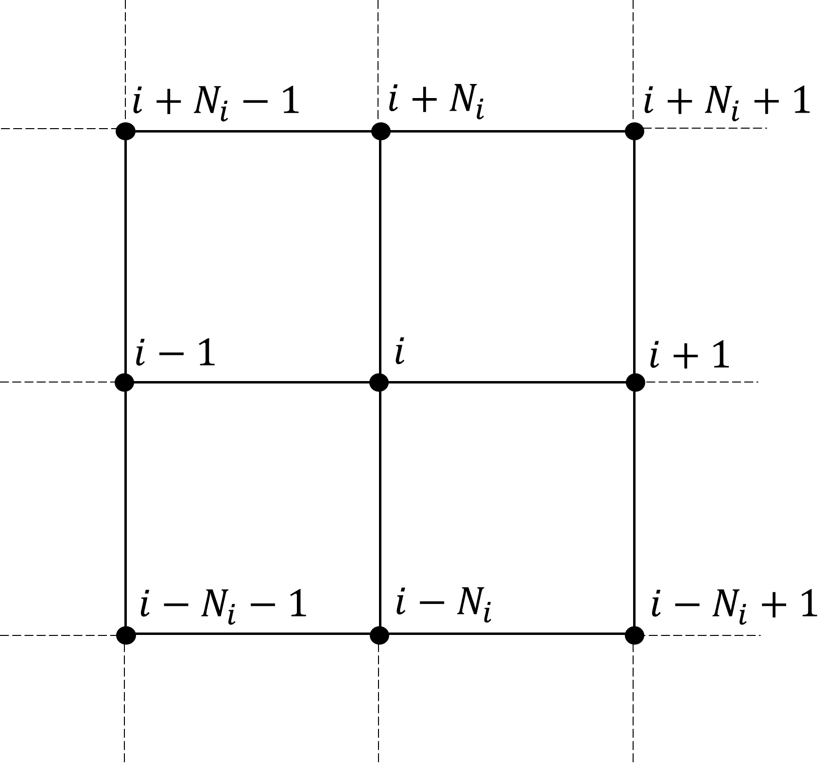
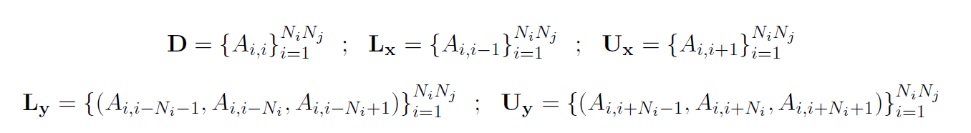
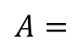
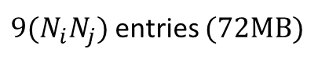
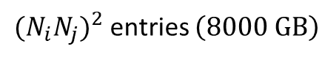
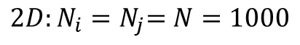
Numerical consideration PyTorch [1] and Iterative solver
$$2D:N_{i}{=N}_{j}=N=1000$$
$$A=$$
${{(N}_{i}N_{j})}^{2}$ entries $\left(8000 GB\right)$
(double precision)
Iterative LSE solver (Jacobi, CG)
$9{(N}_{i}N_{j})$entries $(72MB)$
[1] PyTorch Documentation, https://pytorch.org/docs/stable/sparse.html

Slide 15
Results and discussion

Slide 16
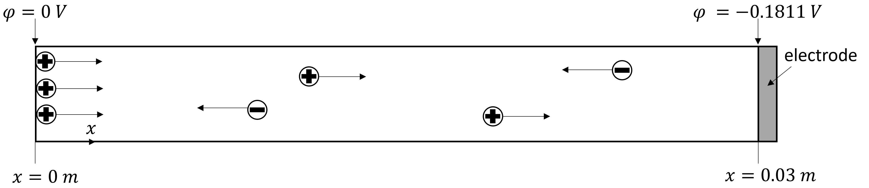
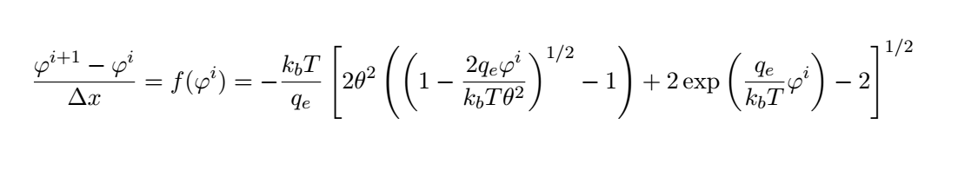
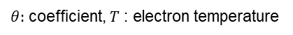
Fully Kinetic Electrostatic Collisionless Plasma 1D Plasma Sheath
Collisionless
Vlasov equation
Boris [2]
Steady state time averaged results
Closed form solution [1]
$θ:$ coefficient, $T$ : electron temperature
[1] M. Pfeiffer et. al., A Particle-in-Cell solver based on a high-order hybridizable discontinuous Galerking spectral element method on unstructured curved meshes
, Comput. Methods Appl. Mech. Engrg, (2019)
[2] Hong Quin et. al., Why is Boris algorithm so good, Physics of Plasmas, (2013)

Slide 17
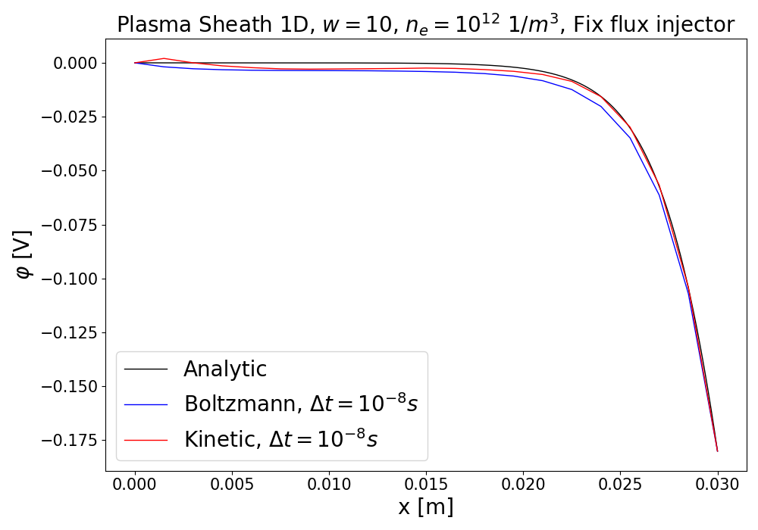

Electric potential $φ\left(x\right)$, w=10, $n_{E}=10^{12}\frac{1}{m^{3}}$
Intel i7 4790K 4.4GHz, 16GB DDR3, Computational times: Boltzmann 411 s, Full Kinetic 1263 s

Slide 18
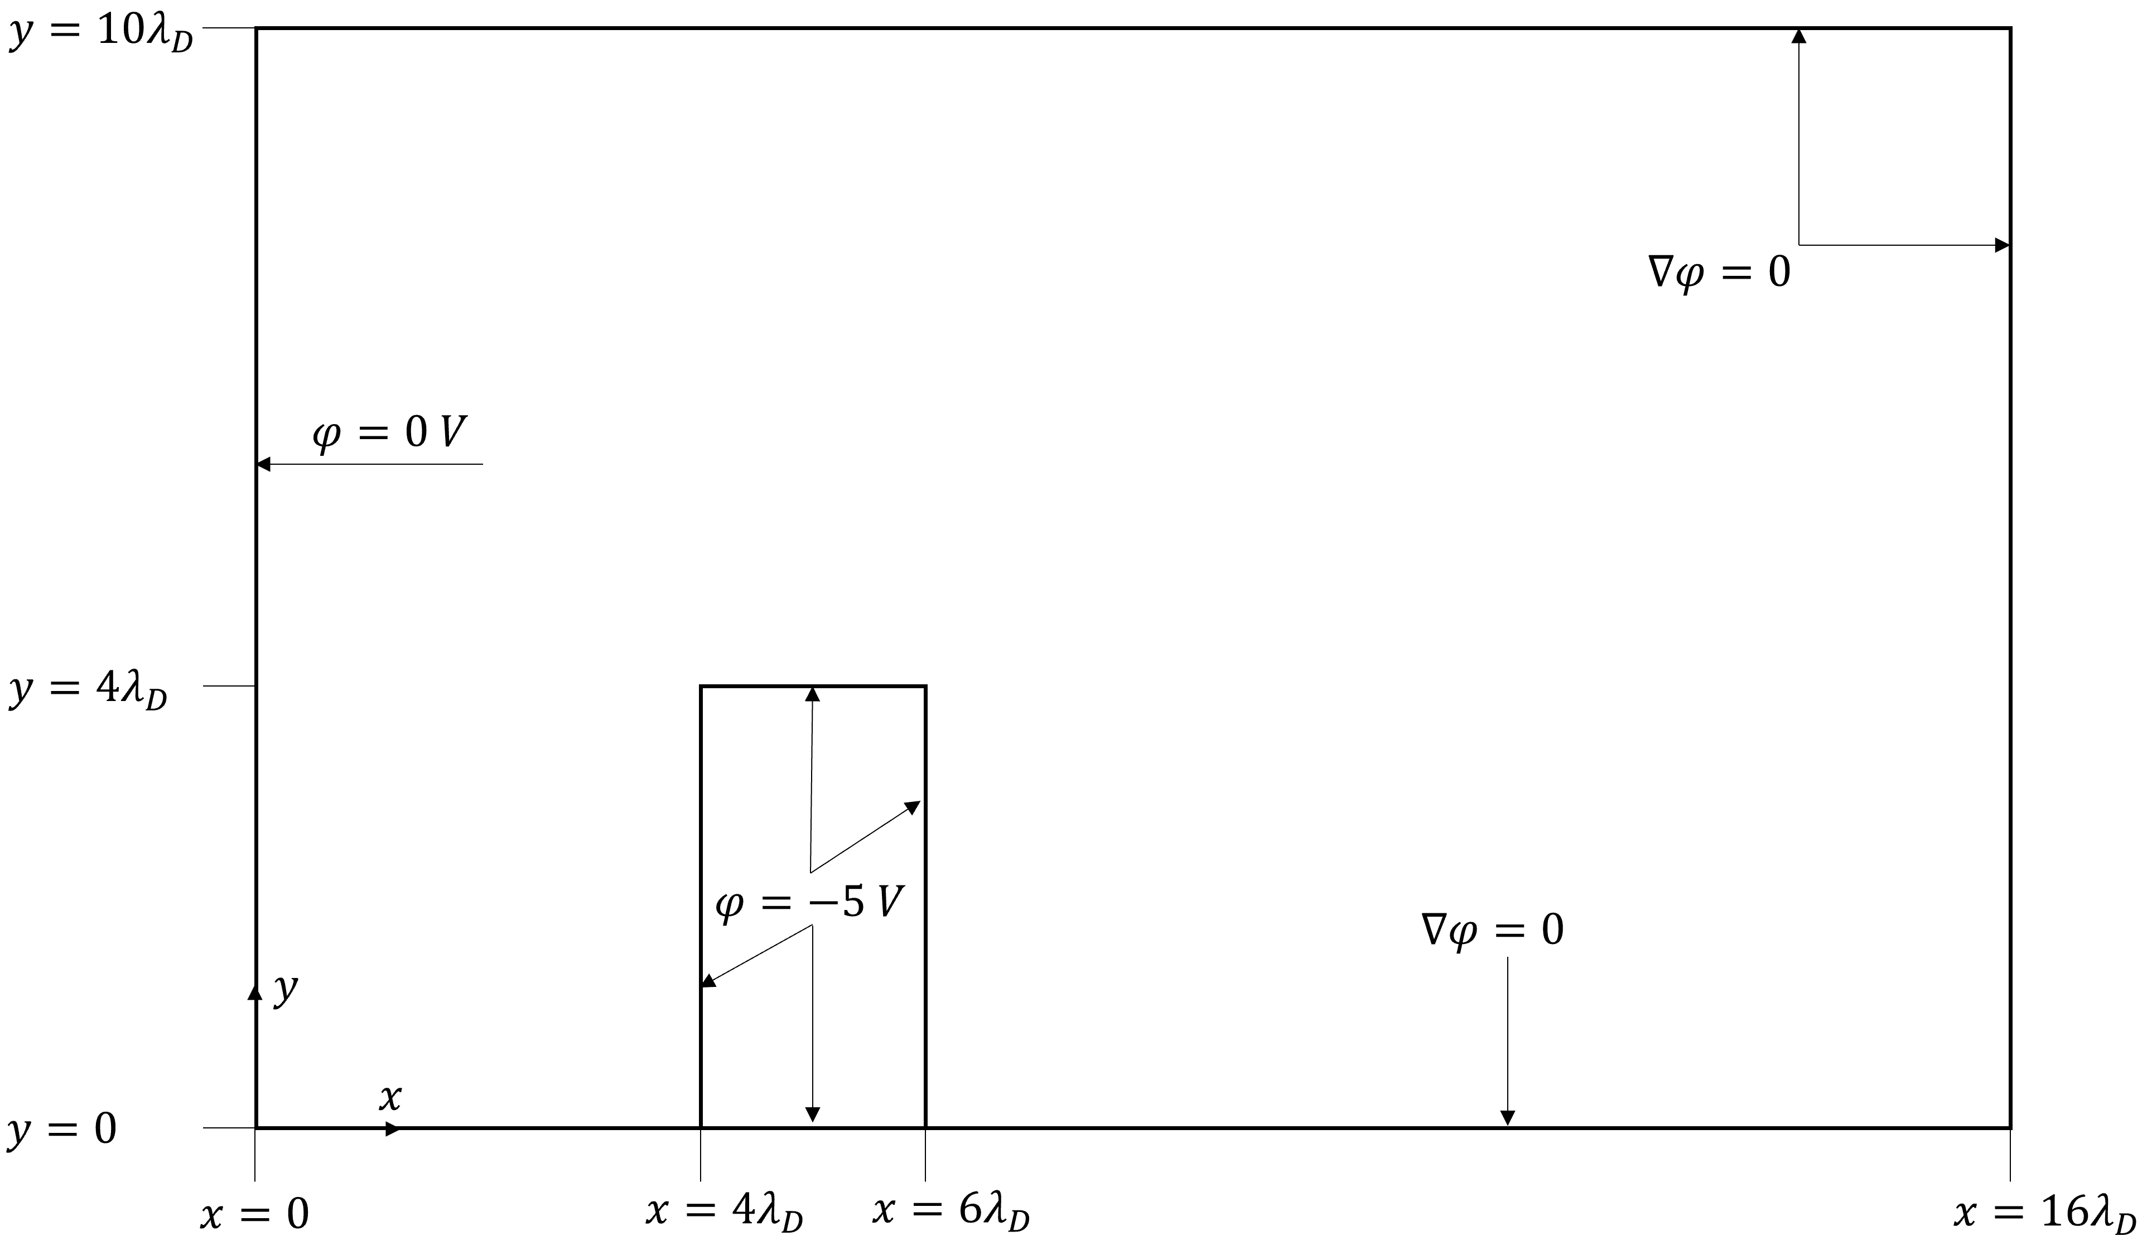
Partially Kinetic Electrostatic Collisionless Plasma 2D Plasma flow over obstacle
Obstacle BC: relfective, periodic, conductor
Plasma injection on left boundary, right boundary open, bottom boundary reflective, upper boundary open
Collisionless
Vlasov equation
Boris PIC
Reference results by Particle In Cell Consulting LLC
https://www.particleincell.com/2011/particle-in-cell-example/

Slide 19
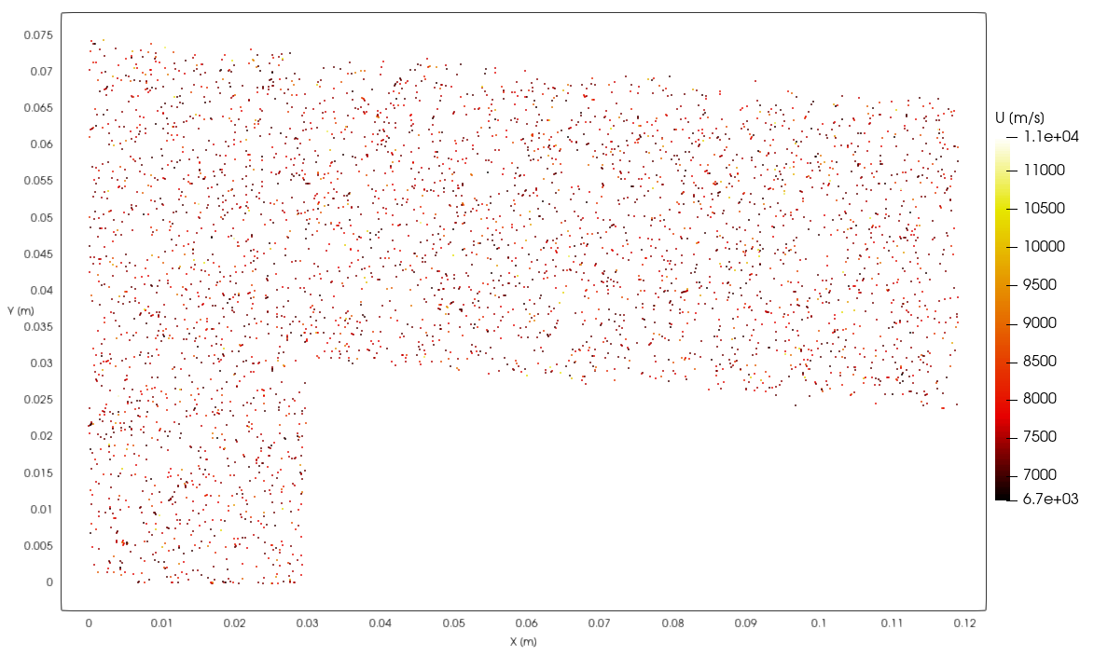
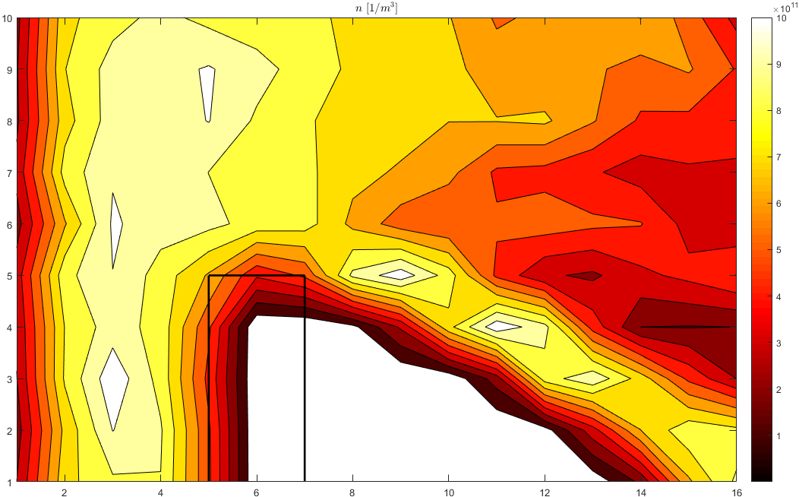
Conductor obstacle particle position/ number density
Ours
Reference

Slide 20
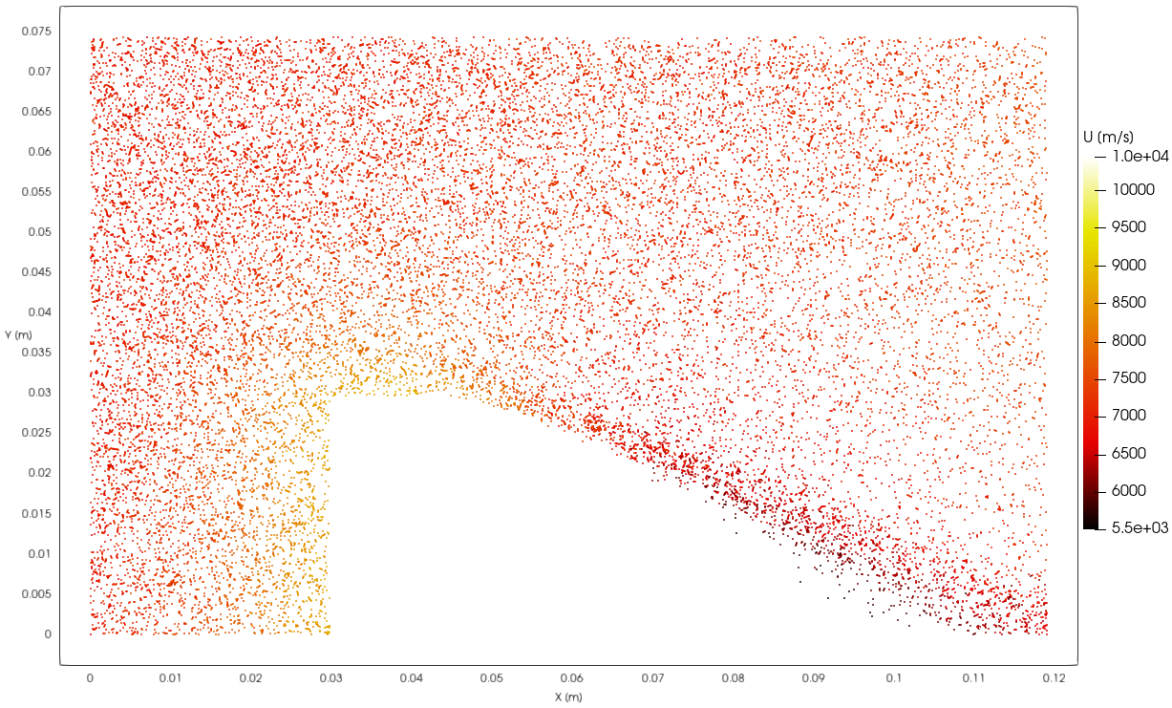
Conductor obstacle particle position/ number density
Ours
Reference

Slide 21

Momentum Correction 2D Test case

Slide 22
Conclusions

Slide 23
Fully Kinetic electrostatic plasma implementation and testing
Domain with obstacles
Solve correction LSE

Slide 24
Thank you for your time Discussion

Slide 25

Reflective obstacle bugged

Slide 26



Boundary crossing detection bugged version
DETECTION CONDITION
$$r=\frac{d_{w}}{d_{p}}<1$$
$$sign(⟨u,n_{BC}⟩)<1$$

Slide 27


Boundary crossing detection solved
DETECTION CONDITION
$$sign(⟨n_{P},n_{Q}⟩)<1$$

Slide 28

problematic case

Slide 29

Reflective obstacle solved

Slide 30


Conductor obstacle Electric Potential
PYSTOPS
Reference

